Slide 1
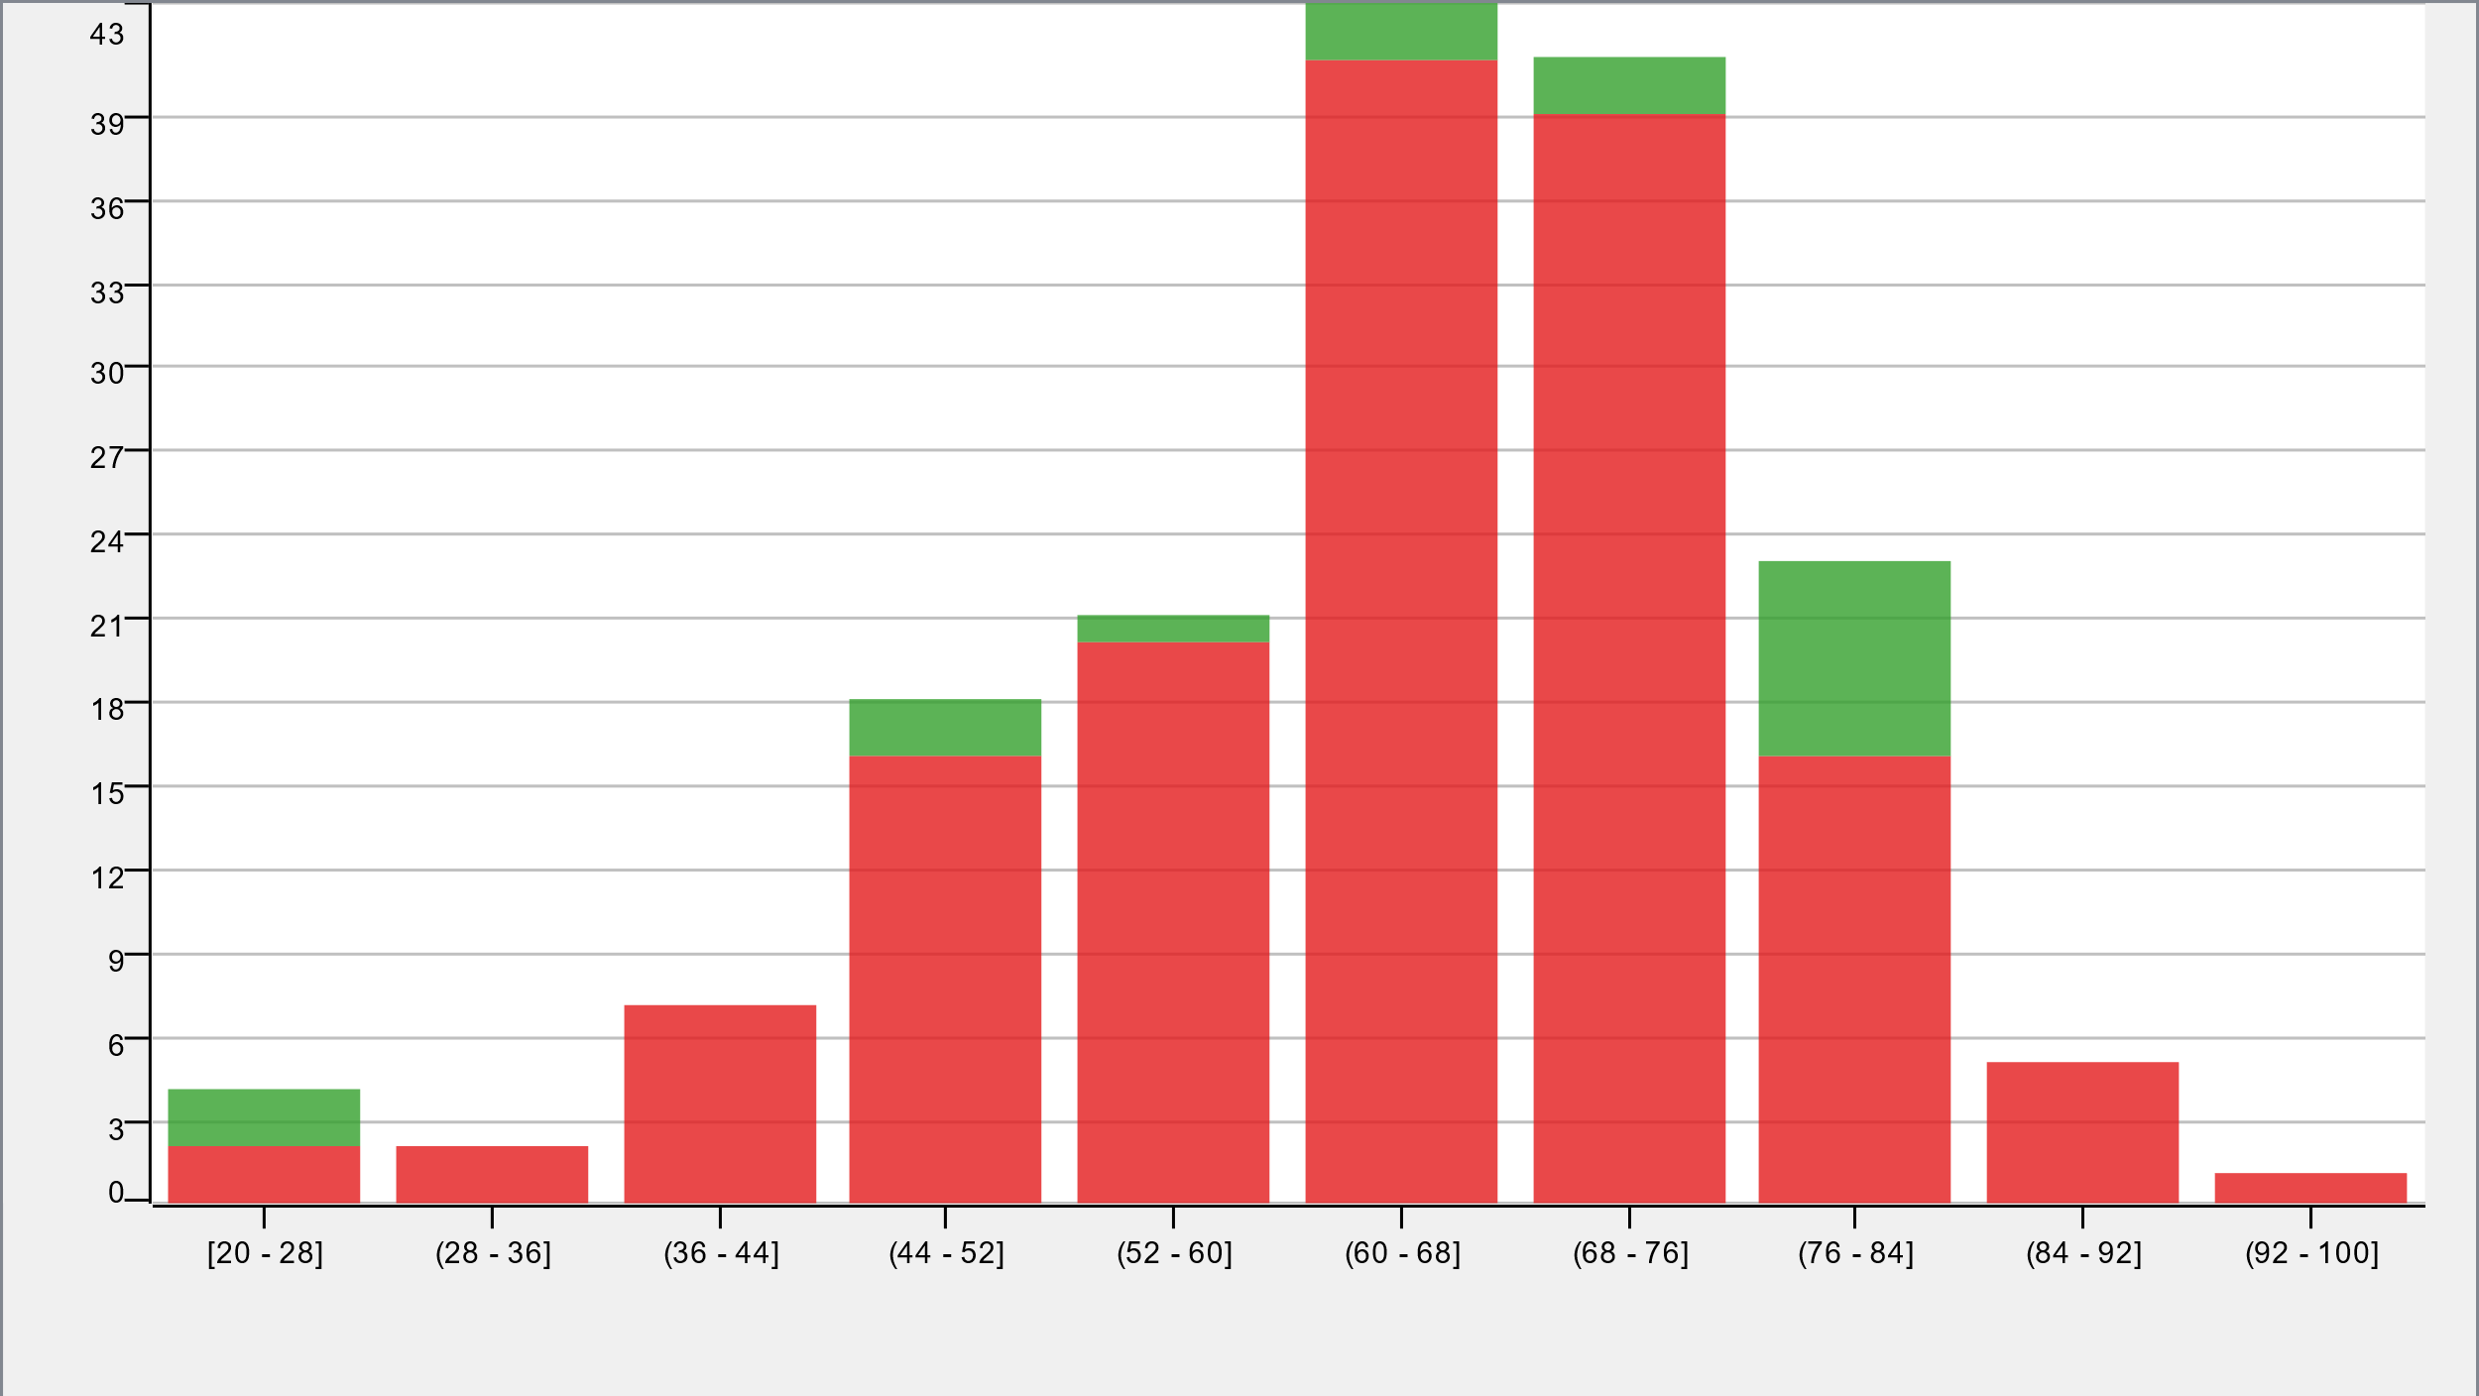
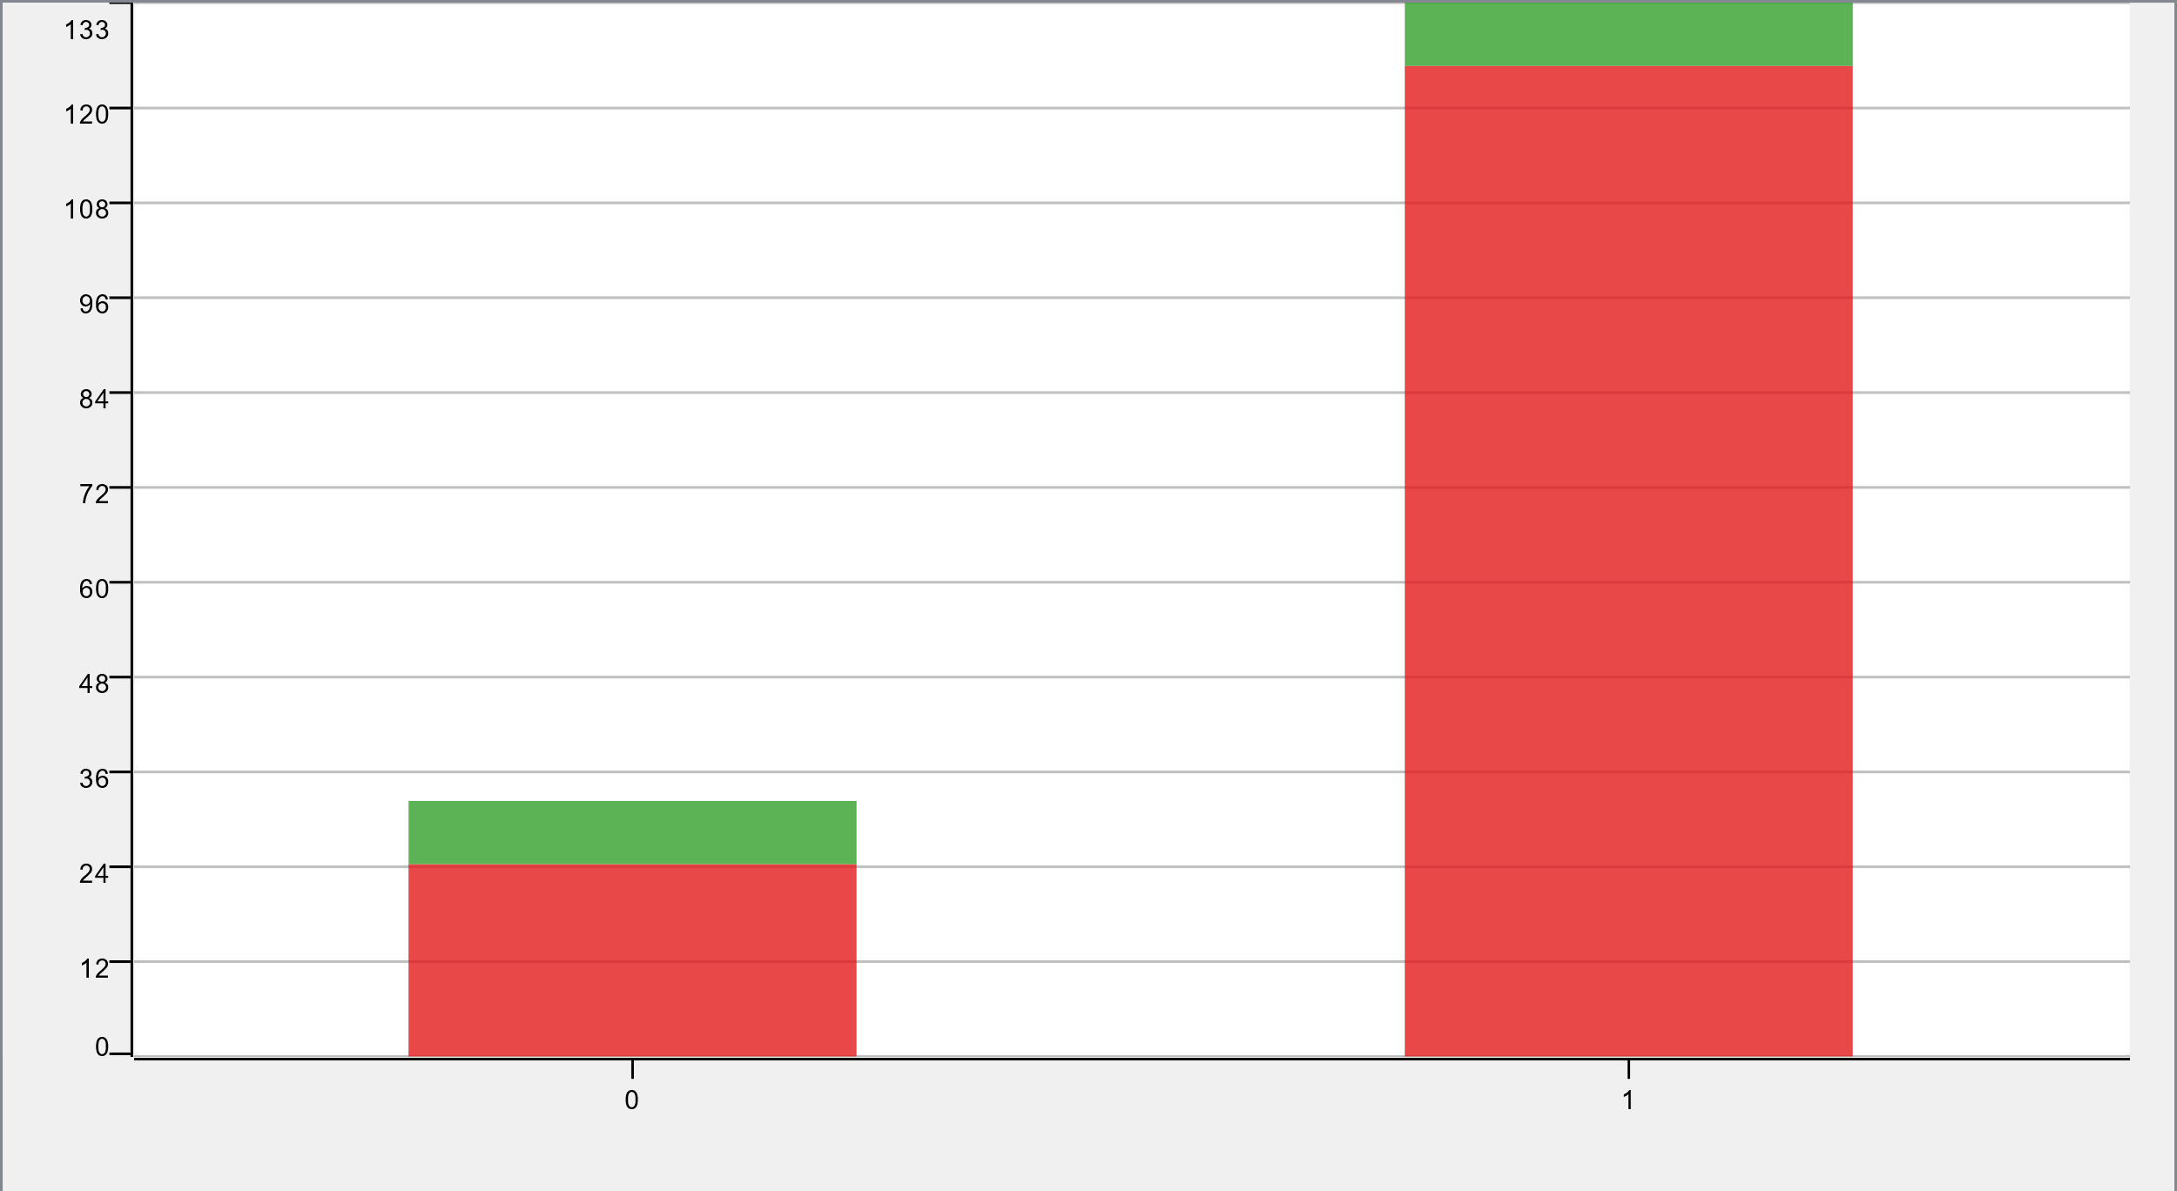
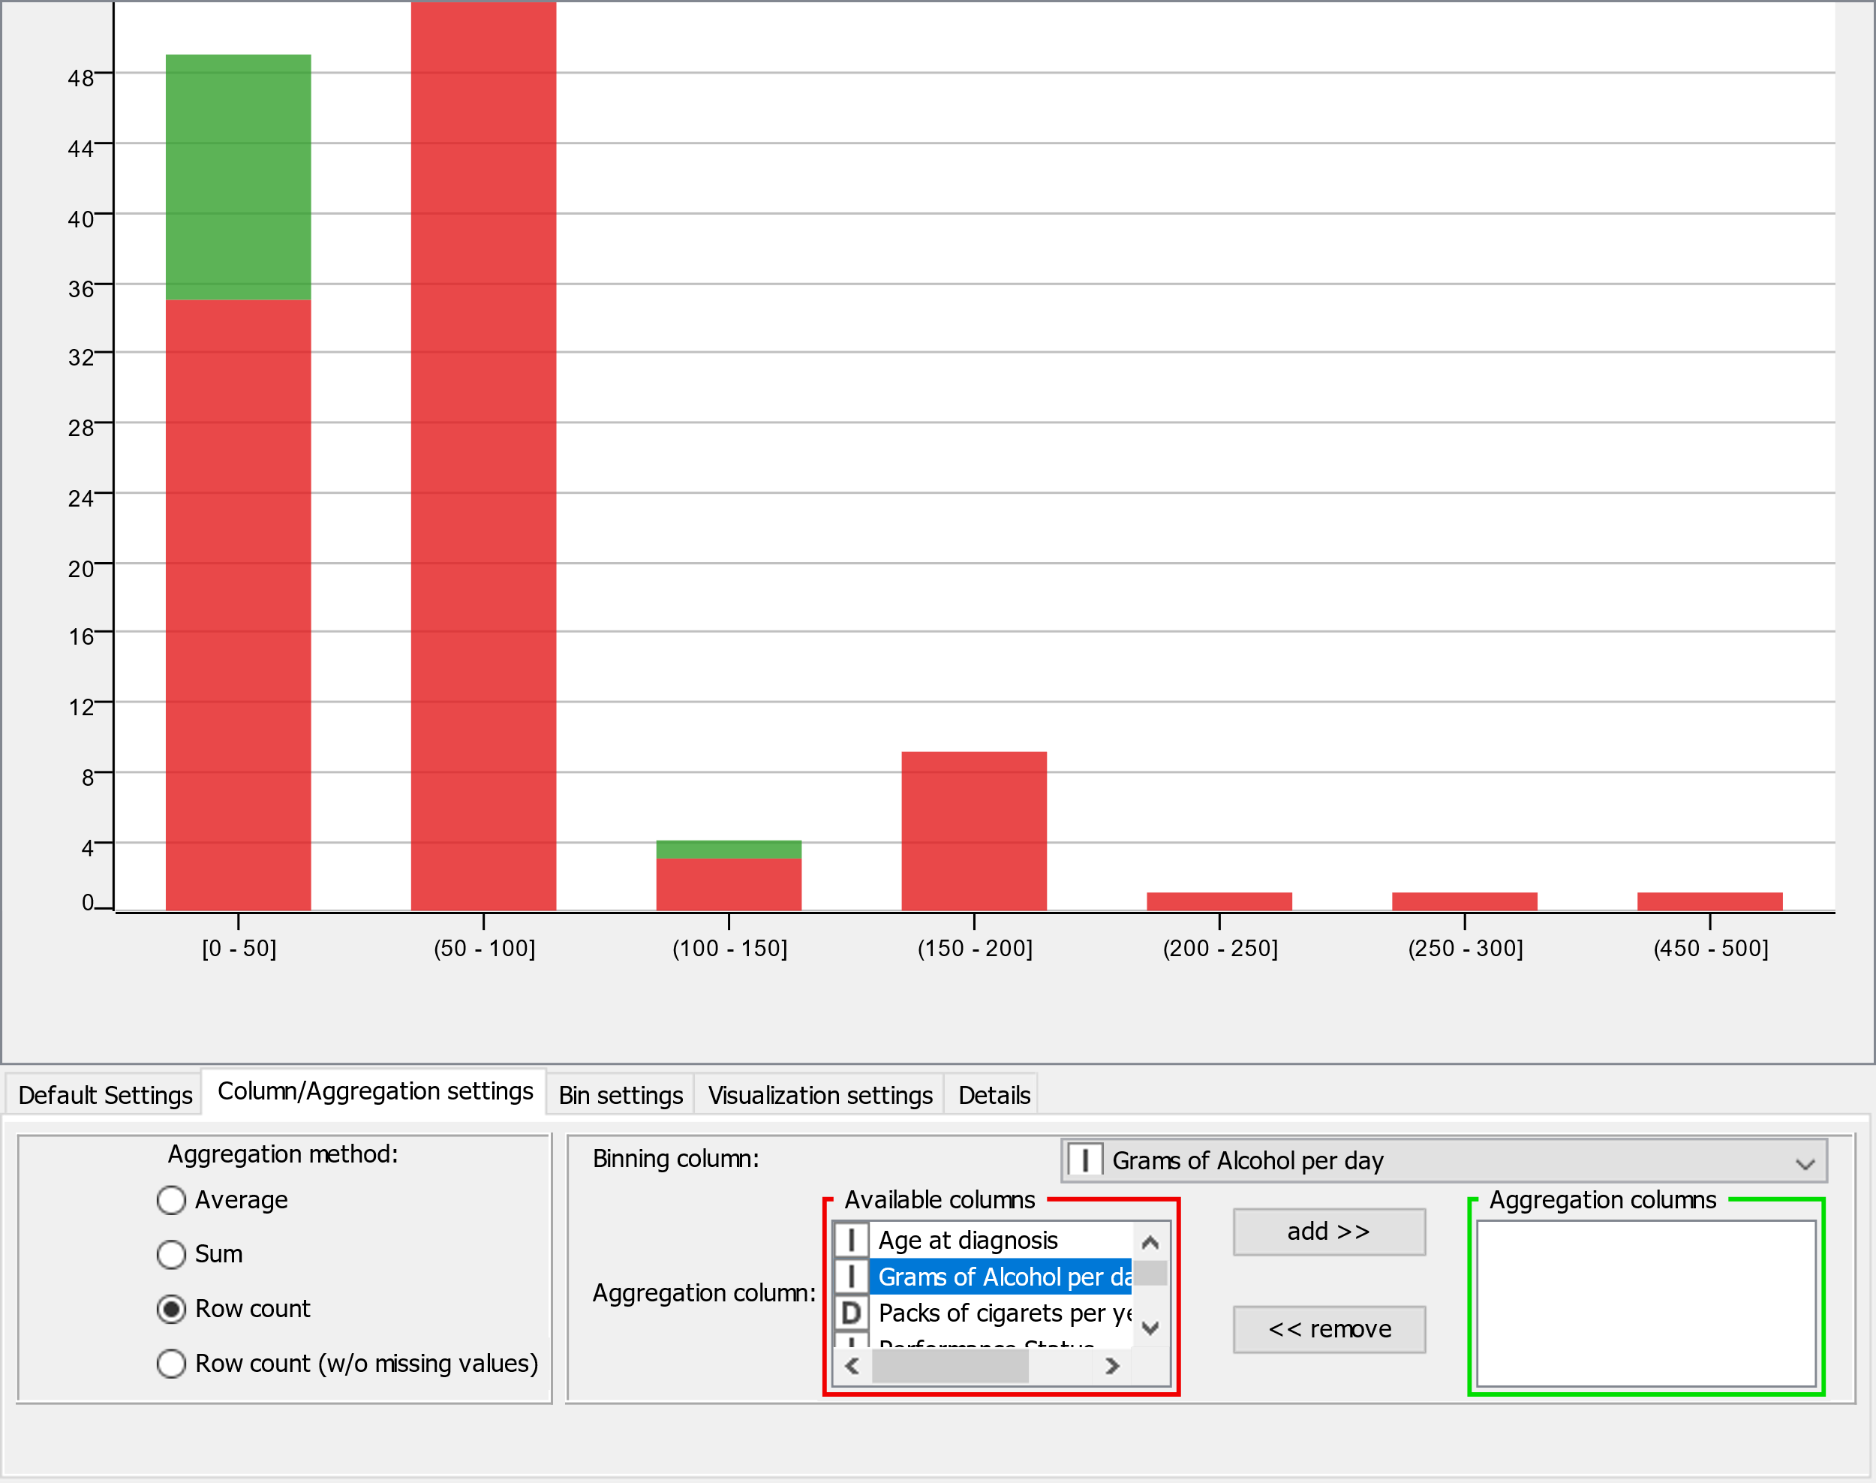
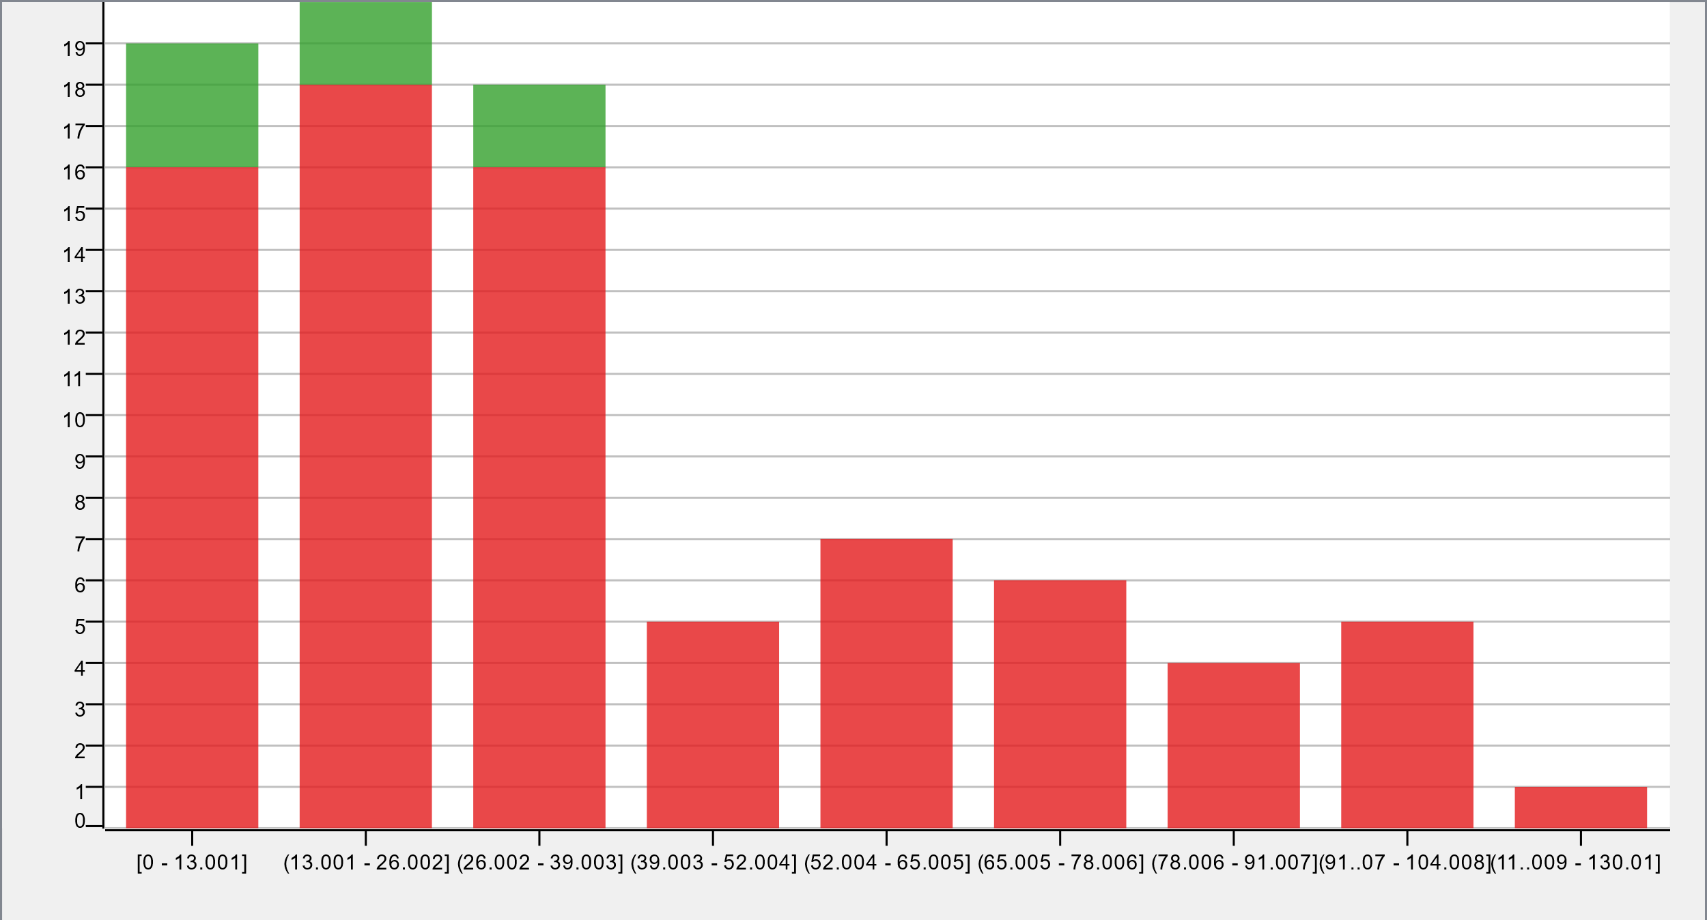
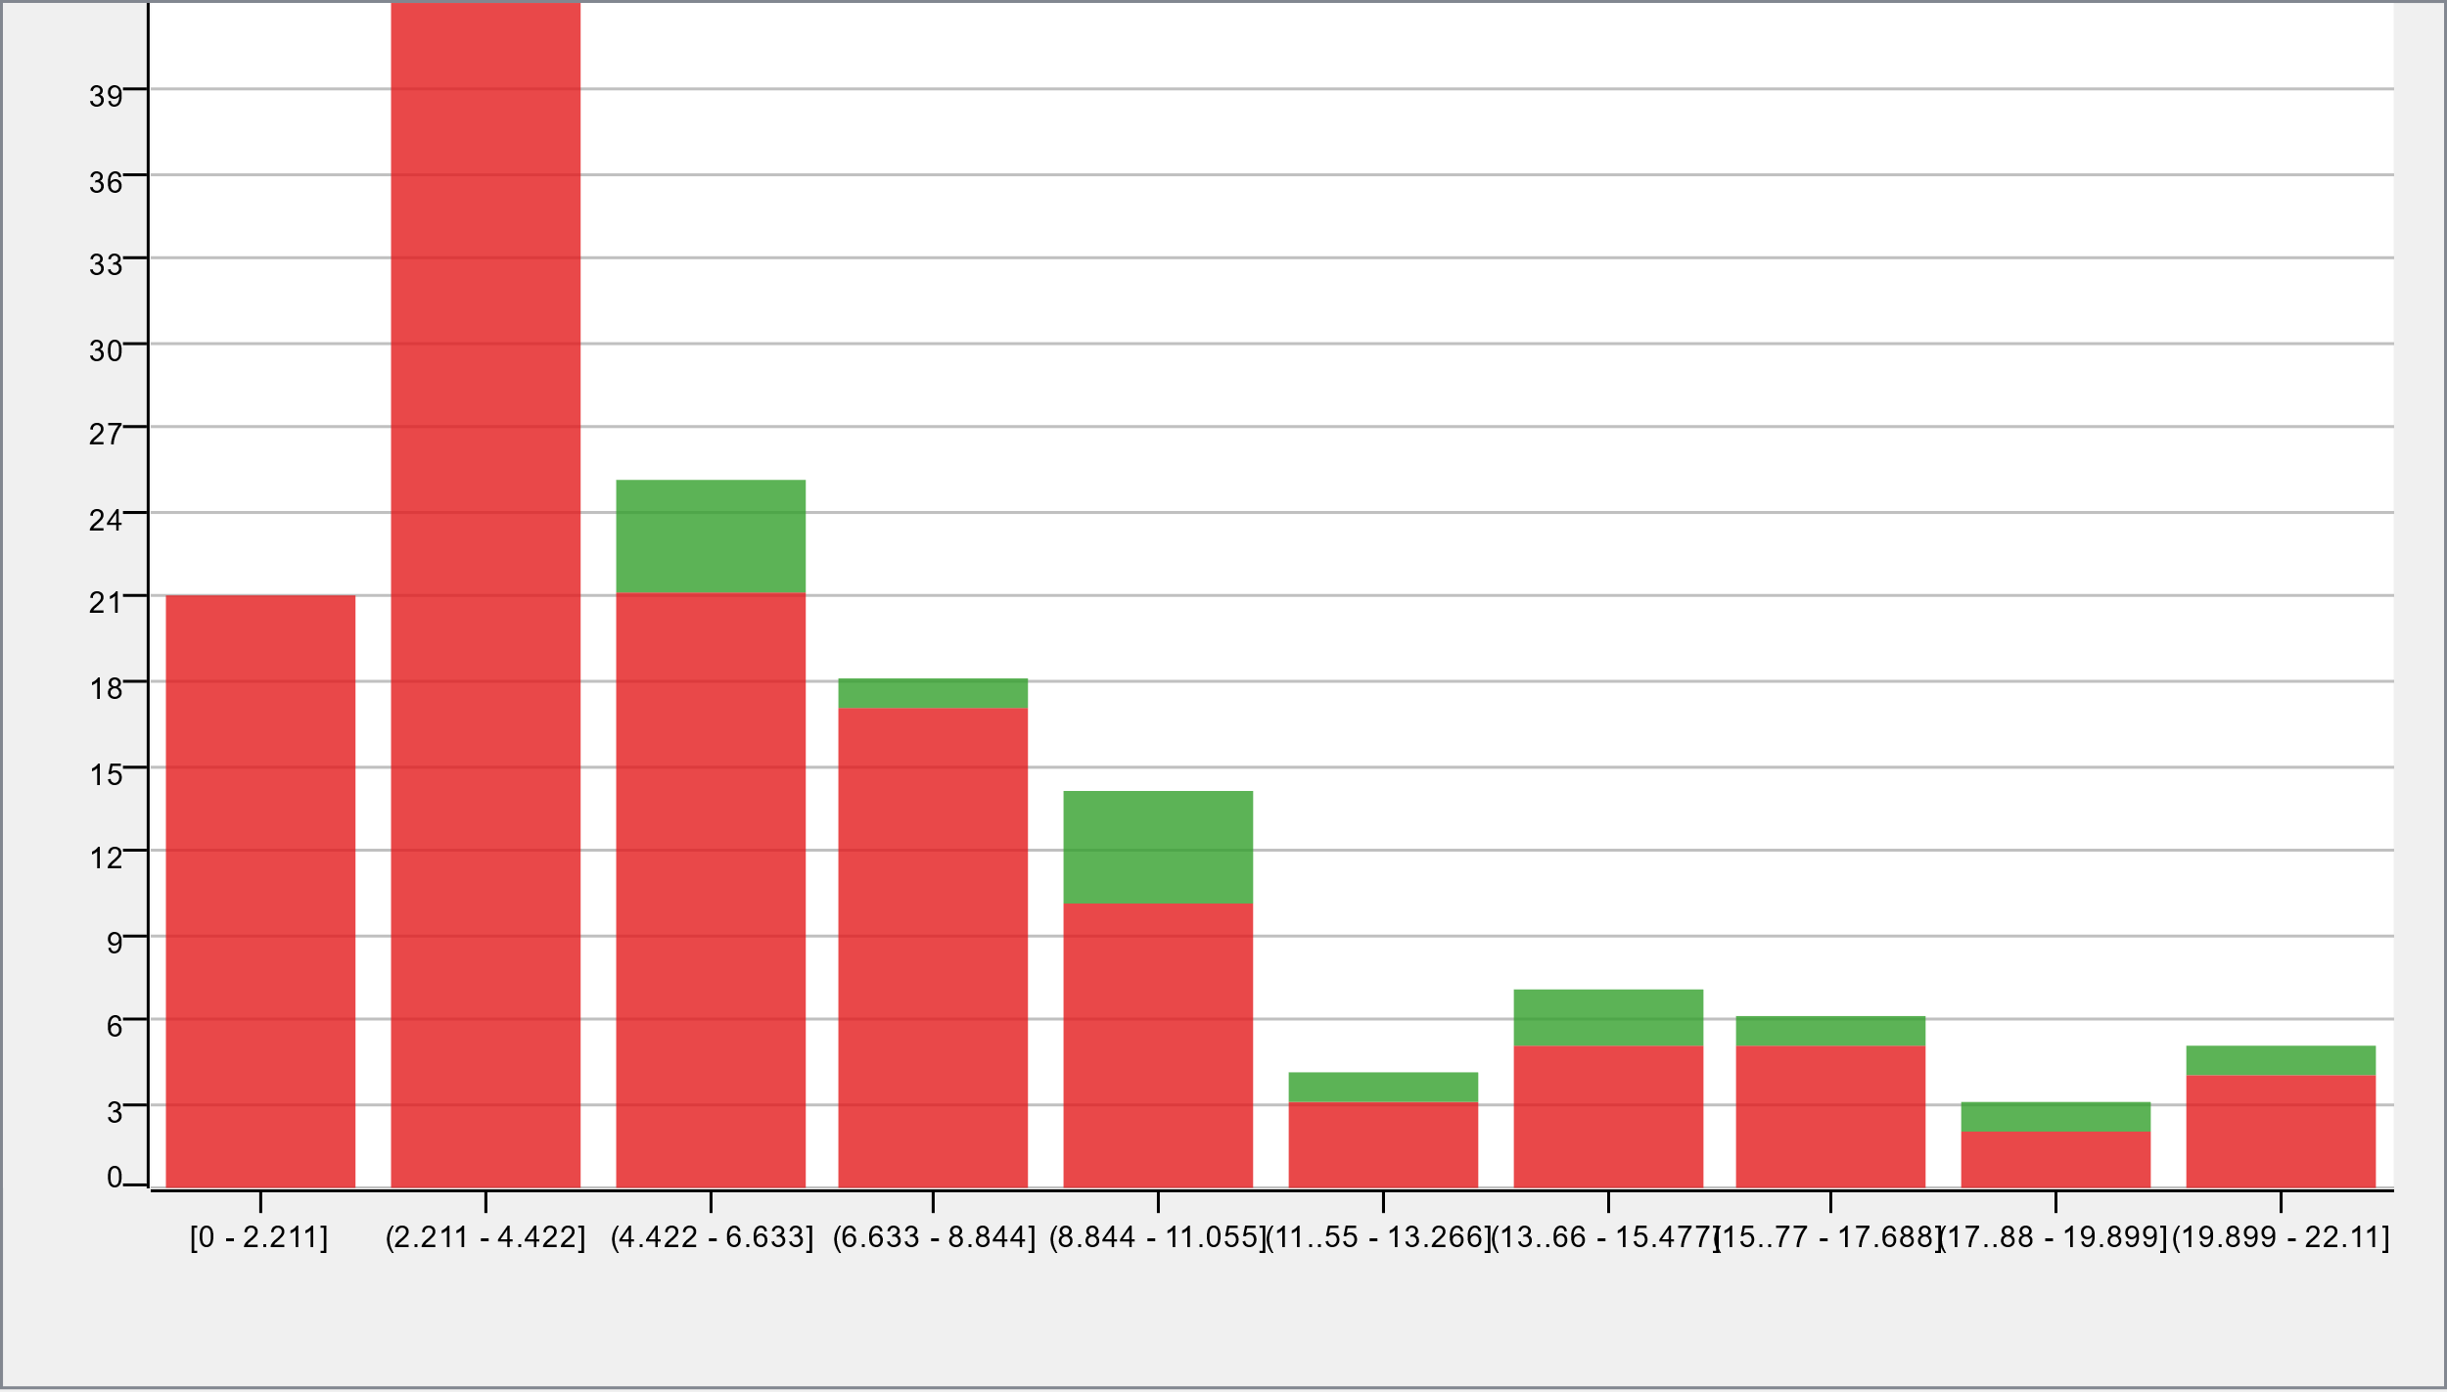
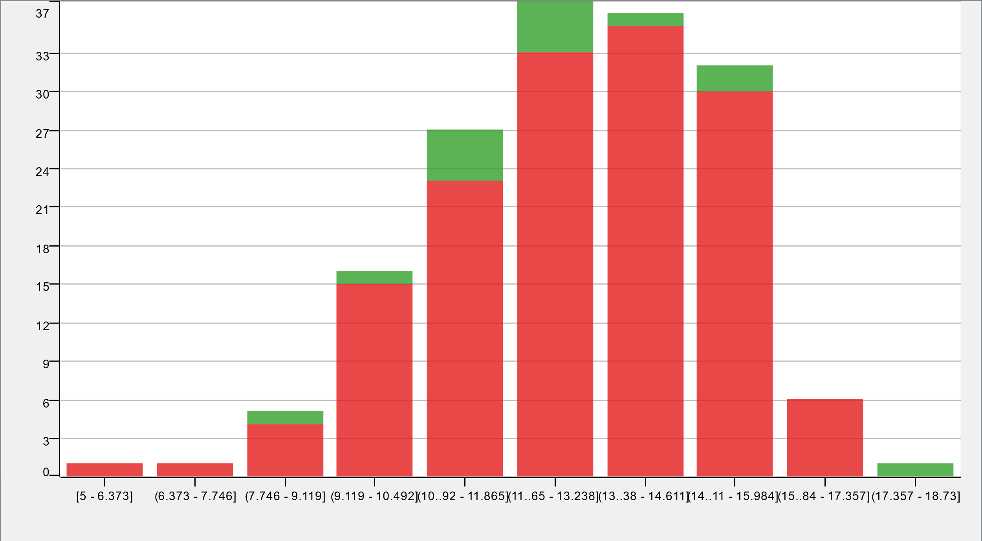
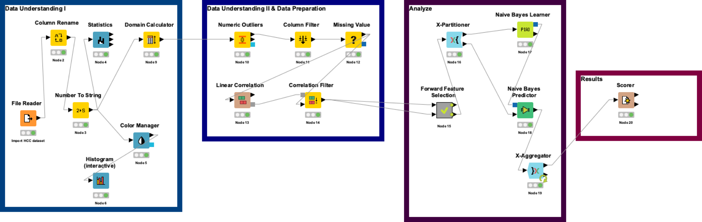
Group 10: HCC Survivals
Ashish Soni, Darshit Paresh Shah, Momtaj Anar Monni, Roland Schnee
Challenge
Dataset
Predict whether a patient will survive the diagnosed liver cancer
Positives (1): Survives
Negatives(0): Death
Number of Instances: 165
Number of Attributes: 49 + class attribute
24 nominal features with 2 values each
Data Understanding
Only 8 patients have complete data.
Non-Ignorable Missing Values.
No Semantic and Syntactic Errors
Outlier Treatment – Closely Permitted Value
Missing Value Substitution – Median / Most Frequent Value
Data Preparation
Remove columns with missing values >60
Forward Feature Selection :
7 attributes ~ 79%
Correlation Threshold – 0.7
Selected Attributes
Hepatitis B Core Antibody
Hepatitis C Virus Antibody
Endemic Countries
International Normalized Ratio
Ascites degree
Alpha-Fetoprotein (ng/mL)
Mean Corpuscular Volume(fl)
Alkaline phosphatase (U/L)
Age @ diagnosis - Gender,
Grams of alcohol per day - Oxygen saturation
Major dimension of nodules (cm) - Haemoglobin
Modelling
Evaluation
Partitioning
Cross Validation-10 fold
Classification Model
Naive Bayes
Naive Bayes
Accuracy ~ 77%
Results
7 attributes are enough to classify the given instances.
Dataset is too small and has too many missing values, therefore achieving a better/perfect accuracy is difficult.

